Slide 1
For a Synodal Church: Communion, Participation and Mission
Adapted for individuals with developmental disabilities
Maggie Rousseau, M.Ed.
mrousseau@archatl.com

Slide 2
Notes:
... We recall that the purpose of the Synod, and therefore of this consultation, is not to produce documents, but “to plant dreams, draw forth prophecies and visions, allow hope to flourish, inspire trust, bind up wounds, weave together relationships, awaken a dawn of hope, learn from one another and create a bright resourcefulness that will enlighten minds, warm hearts, give strength to our hands…” Preparatory Document, no. 32 (quote from Pope Francis, Address at the Opening of the Synod of Bishops on Young People [October 3, 2018])

Slide 3
Rules for our conversation are like prayers:
P – PRAY and PONDER before and after you speak.
R – Take RESPONSIBILITY for your own thoughts and feelings.
A – ALLOW others to speak and to share.
Y – YOU – Be attentive to your own thoughts and feelings.
E – Use EMPATHETIC listening.
R – RESPECT every person as Jesus taught us:
Love one another.
Notes:
Before we start, we do have some rules for our talks.
P – PRAY and PONDER before and after you speak. Ask our Lord to be in your heart and mind and on your lips as you begin to speak.
R – Take RESPONSIBILITY for your own thoughts and feelings, avoiding the temptation to blame others.
A – ALLOW others to speak and to share without correction or criticism.
Y – YOU – Be attentive to your own thoughts and feelings. Ask yourself, “Why do I feel or think this way?”
E – Use EMPATHETIC listening, and be attentive not just to words but, also to feelings being shared.
R – RESPECT every person as Jesus taught us: love one another.

Slide 4
Materials for participation
Computer or phone
Paper
Pencil, pen, or crayon
Scissors
Glue
Pictures
Candle
Bible

Slide 5
Ideas for engagement
Be welcoming
Evaluate the environment for physical and sensory barriers
Use person first language
Encourage participation
Speak slowly
Provide prompts using concrete language
Provide time for reflection and response
Avoid the temptation to do it yourself

Slide 6
Prayer to the Holy Spirit
We stand before You, Holy Spirit, as we gather together in Your name.
With You alone to guide us, make Yourself at home in our hearts;
Teach us the way we must go and how we are to pursue it.
We are weak and sinful; do not let us promote disorder.
Do not let ignorance lead us down the wrong path nor partiality influence our actions.
Let us find in You our unity so that we may journey together to eternal life and not stray from the way of truth and what is right.
All this we ask of You, who are at work in every place and time, in the communion of the Father and the Son, forever and ever.
Amen.
Notes:
Let’s start with a prayer to the Holy Spirit. If needed, use the attached Adapted Prayer to the Holy Spirit.

Slide 12
What is a Synod?
We gather together to listen, talk, pray, and decide together how to act so that others can get to know Jesus.
This gathering is called a Synod.
Notes:
Pope Francis has asked all of us to come together to talk about our catholic faith and how we can build our Church.

Slide 13
Matthew 18:20
“For where two or three are gathered together in my name, there am I in the midst of them.” (Mt 18:20)
How can we share Jesus with others?
Notes:
So Jesus is here, right? Light a candle at home to remind you that Jesus is with us as we gather together.

Slide 14
The Good News
Pope Francis has asked us to come together as Church to help spread the good news of Jesus.
Where is the story of Jesus found?

Slide 15
The Gospel
The story of Jesus is found in the bible.
There are many books in the bible but the four gospels from Matthew, Mark, Luke and John tell us about Jesus’ life here on earth.
We read about his birth, his ministry (or work with others), how he died, and his return to heaven or the resurrection.
Think about the life of Jesus.
Notes:
Draw a picture or write a short paragraph to about Jesus and his life to share with others.

Slide 16
Question 1: Communion
Think of something that makes you happy (brings joy) when you go to church or are together with your church family.
Think of something that made you sad or angry at church or when you were with your church family.
Did you ever hear God telling you something at church?
Did someone act in a way that reminded you of God at church?
Notes:
One at a time, let us share what makes us happy and what might make us sad at church.

Slide 19
Question 2: Participation
Do you participate in activities at Church? If so, what?
Are there other activities you would like to try?
Have you gone to a friend’s church? Did they have an activity that you want your parish to do or have?
Notes:
DISCUSSION (If you would rather draw a picture or pick some pictures out of a book or magazine of things that you like to do at church.

Slide 21
Question 3: Mission
What does “the Eucharist” mean to you?
Does going to Mass give you energy for your week to be a good follower of Jesus? Did you hear Jesus ask you to do something to help the church?
Do you like going to Sunday Mass? If so why, if not, why not.
Do you listen to the bible readings at Mass? Does the priest help you to understand the readings?

Slide 23
Go to Mass
----------------
Sing in choir
----------------
Lector
----------------
Priest
----------------
Nun
----------------
Kitchen help
----------------
Baptism
----------------
Eucharist
----------------
Confirmation
----------------
Nursery worker
-------------------------
Eucharistic Minister
-------------------------
Life Teen
Musician
------------------- Altar server
-------------------
Bible study
-------------------
Knights of Peter Claver
-----------------------------
Attend Catholic School
-----------------------------
Bell ringer
-------------------
Pray
-------------------
Christmas program
-------------------
Knights of Columbus
-----------------------------
Praise and Worship
-----------------------------
Attend a retreat
-------------------
Parish family
Notes:
Cut pictures out for choice making. Match word to picture.

Slide 24
Go…
What is one thing the church can do to help us?
What is one thing that we each can do to help our church?
…in peace to love and serve the Lord!!!
Notes:
Think about our conversation today. We listened, we talked, we prayed, and we shared some ways we can live our faith and help our church. And we discussed how our church can help us.
What does the priest say at the end of Mass???

Slide 25
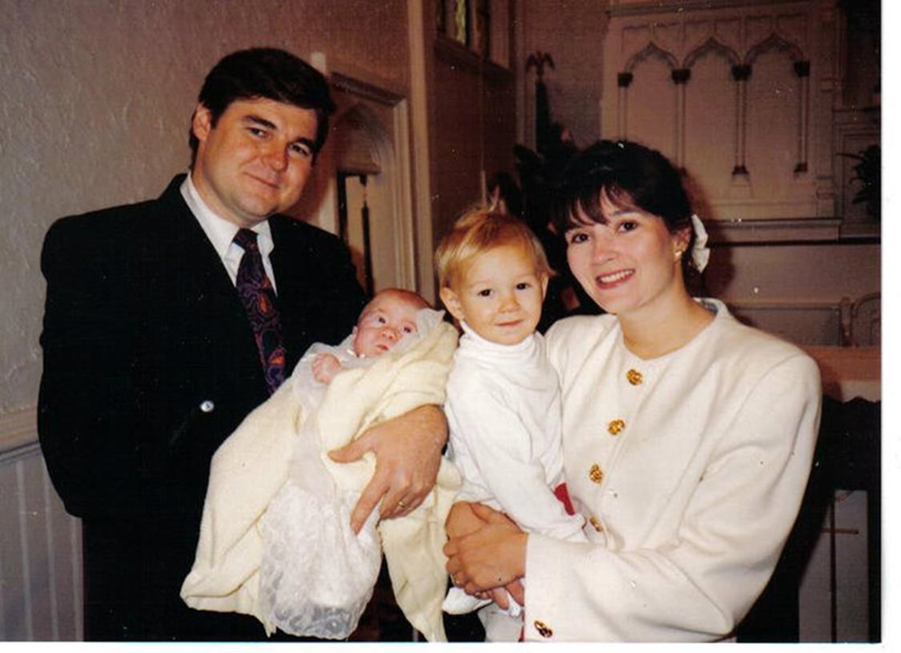
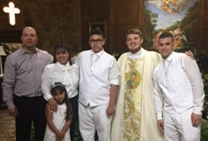
Love Is Our First Language
Notes:
Speak with the language of love!

Slide 26
For additional information please contact:
Maggie Rousseau
mrousseau@archatl.com
References:
Synod - Roman Catholic Archdiocese of Atlanta | Atlanta, GA (archatl.com)
Made with: Boardmaker 7 Standard - Tobii Dynavox Global
Google Images

Slide 27
Additional worksheets

